Slide 1
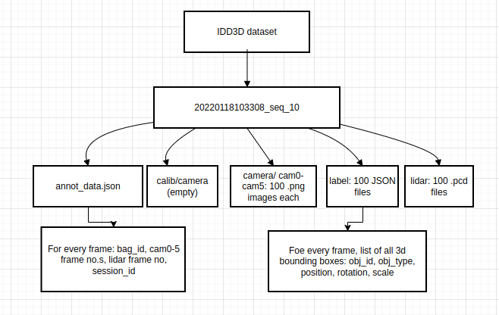
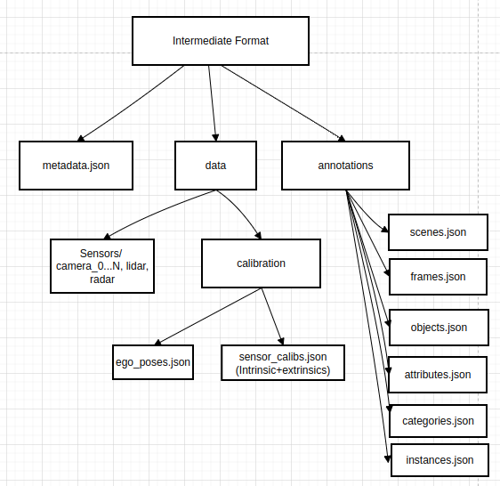
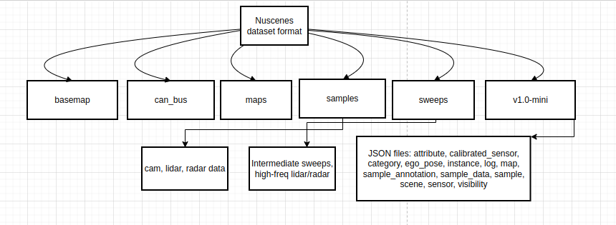
IDD3D to Nuscenes Format Conversion
IDD3D format | Intermediate Format | Nuscenes Format

Slide 2
Intermediate Format
Specification

Slide 3
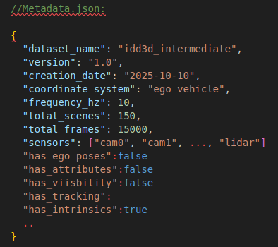
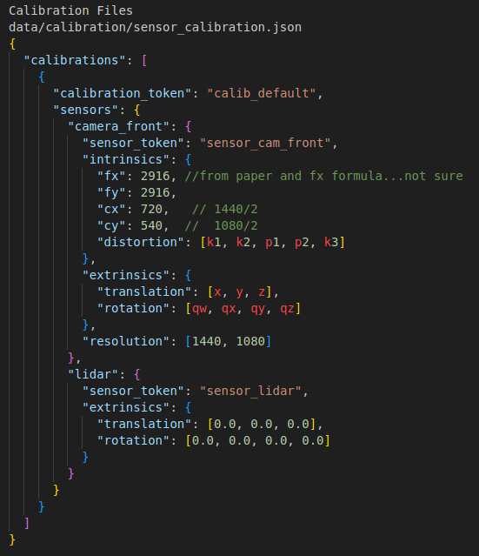
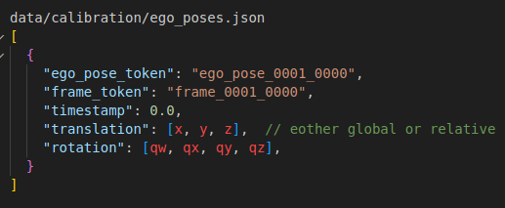
Metadata.json
Sensor_calibration.json
Ego_poses.json

Slide 4
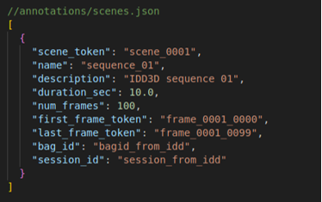
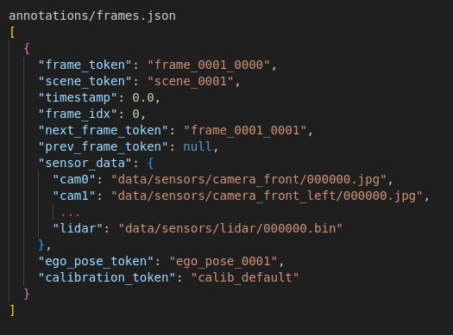
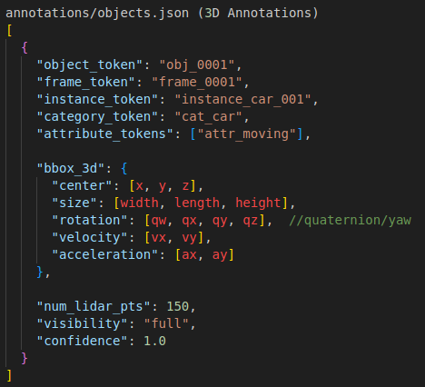
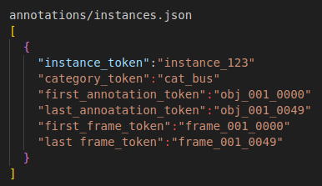
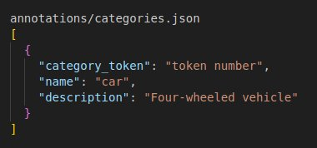
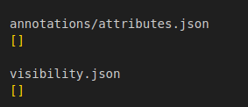
scenes.json
frames.json
objects.json
instances.json
categories.json
attributes.json

Slide 5
Other dataset comparison for Intermediate Format
Dual representation – euler angles and quaternions for rotation, multiple coordinate frame options, etc

